Slide 1
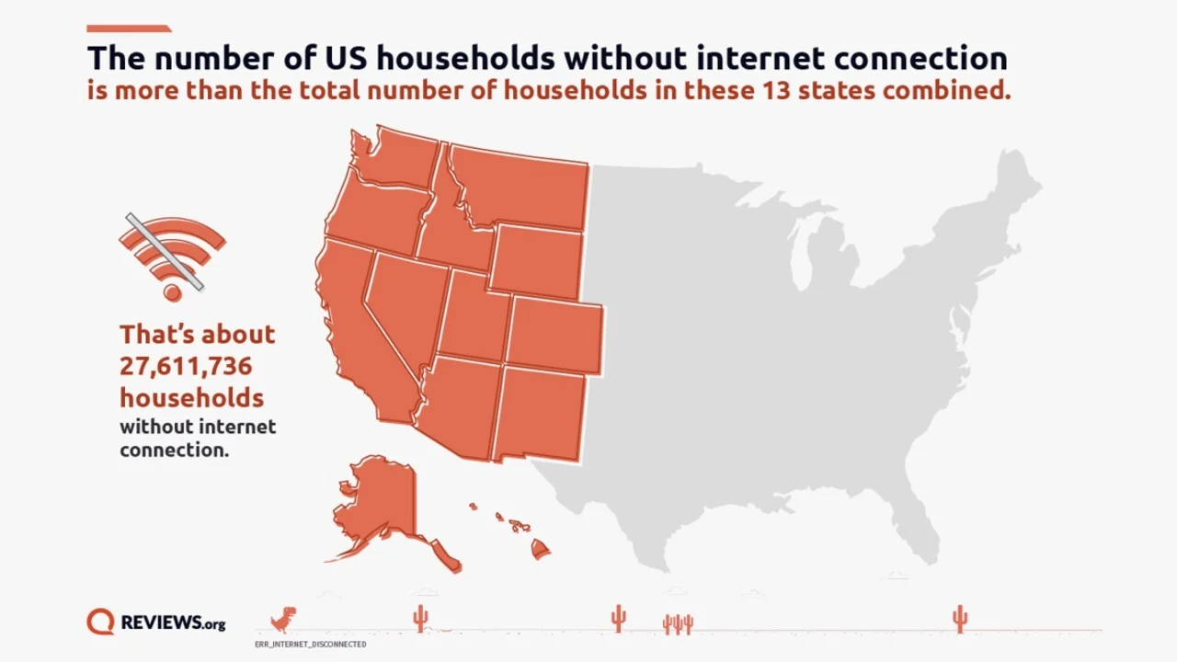
The Digital Divide in the United States
The Problem
The Solution
in this age of the internet 26.7 million households lack internet access despite technology being more prevalent than ever.
Reduce cost of broadband internet.
Build more infrastructure to extend the reach and availability of broadband.
Implementation
The Benefits
Phases | Information
Research | Figure out the cost and most effected areas.
Funding | Acquire necessary funding.
Construction | Build infrastructure.
Implementation | Provide internet to those without.
More households have internet access.
More households have access to remote education.
More jobs become available due to more infrastructure.
More internet subscriptions means more money for ISPs.

Slide 2
References
Cohen, J. (n.d.). Nearly a quarter of US households don’t have internet access. PCMAG. https://www.pcmag.com/news/nearly-a-quarter-of-us-households-dont-have-internet-access

